Slide 1
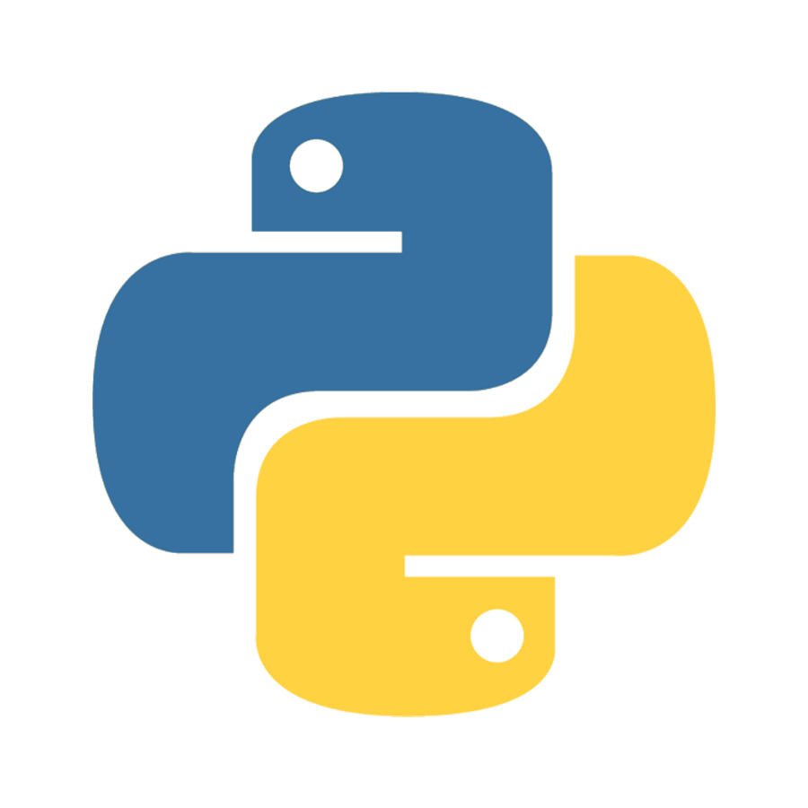
Python Basics

Slide 2


What is a computer?
A computer is an electronic device that processes data, executes instructions, and performs calculations to solve problems and accomplish tasks.

Slide 3
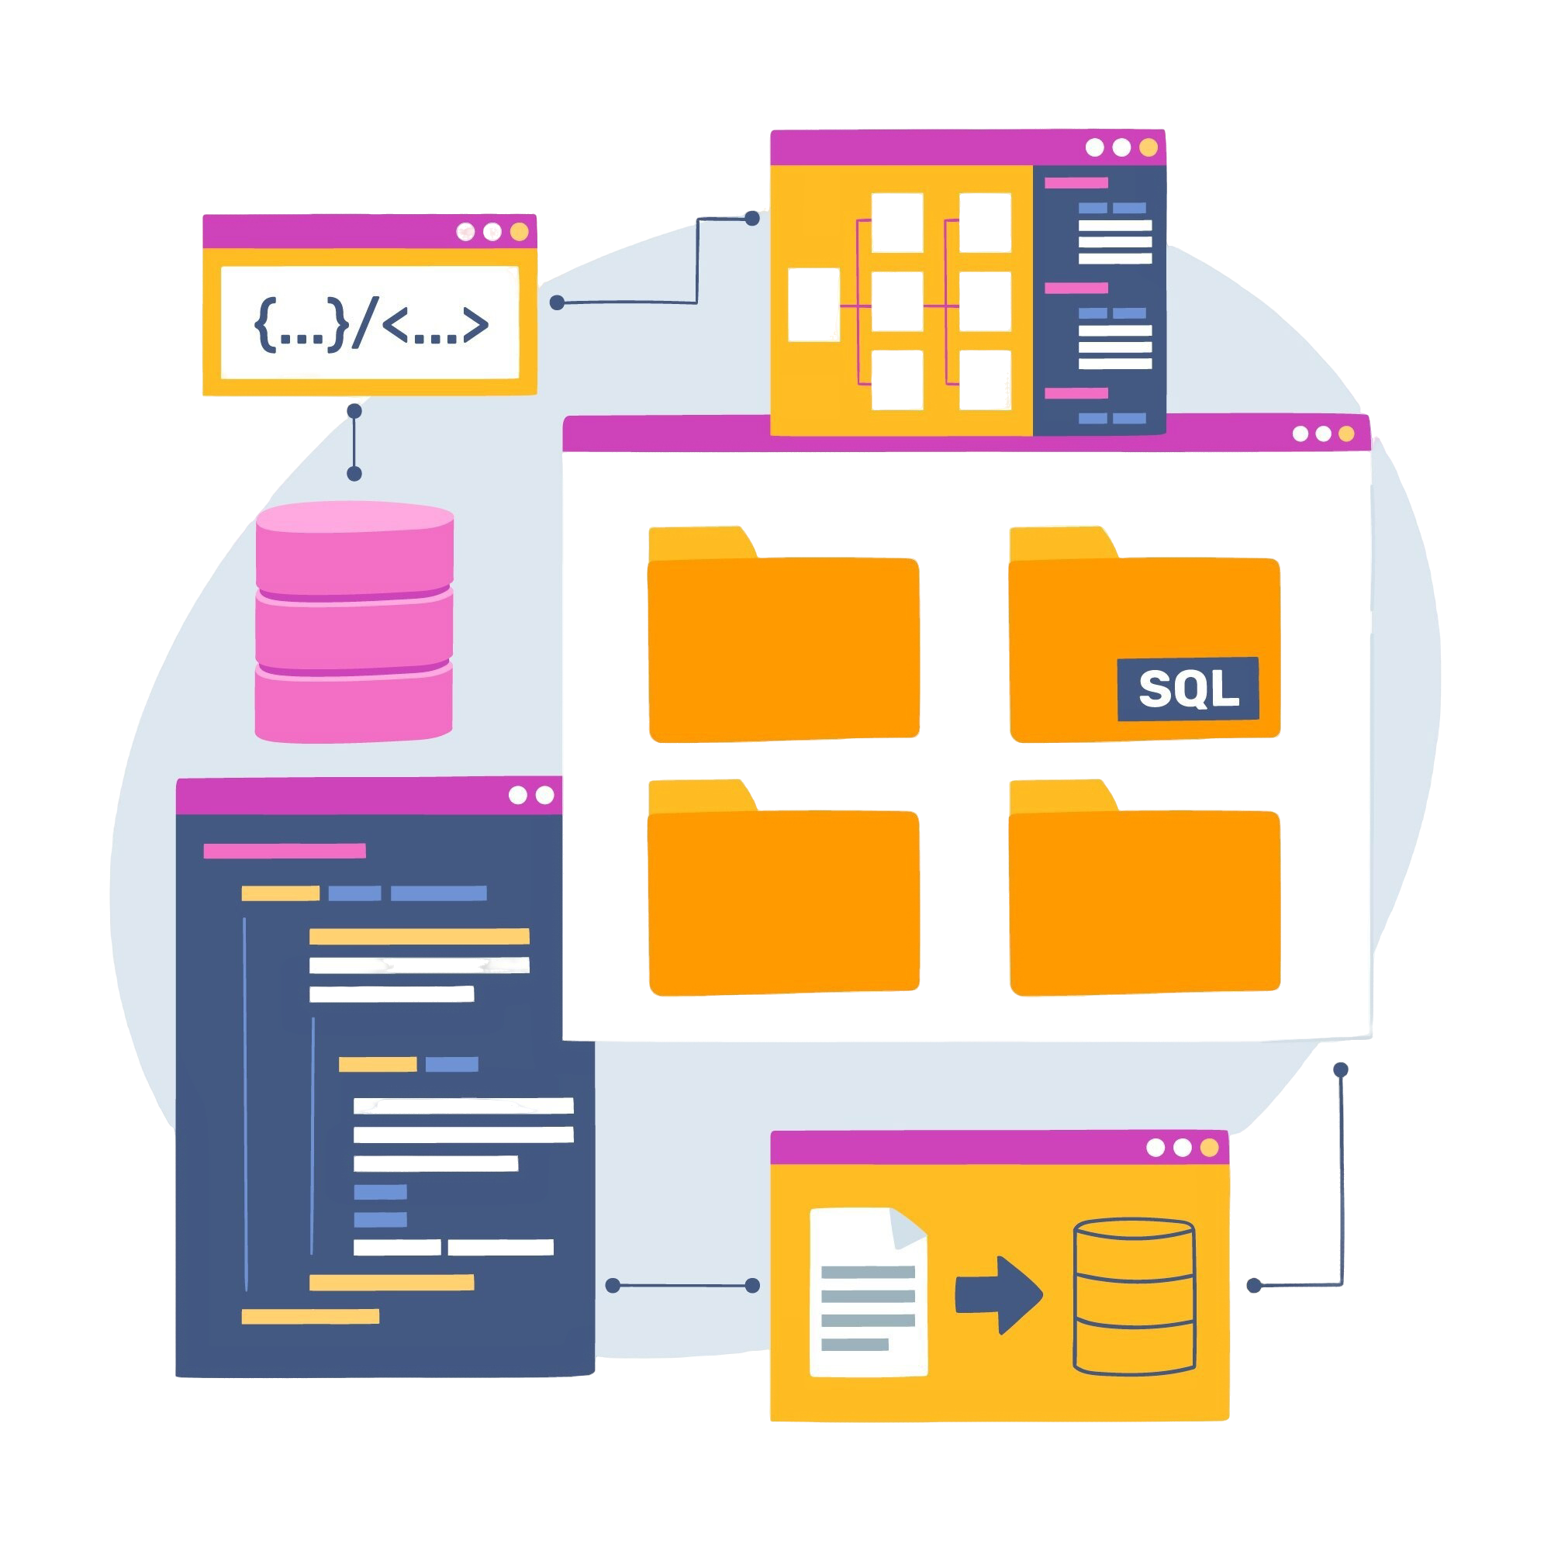
What is Google Colab?
Google Colab is a free cloud-based platform that allows users to write and execute Python code in a browser with Google’s computational resources.

Slide 4
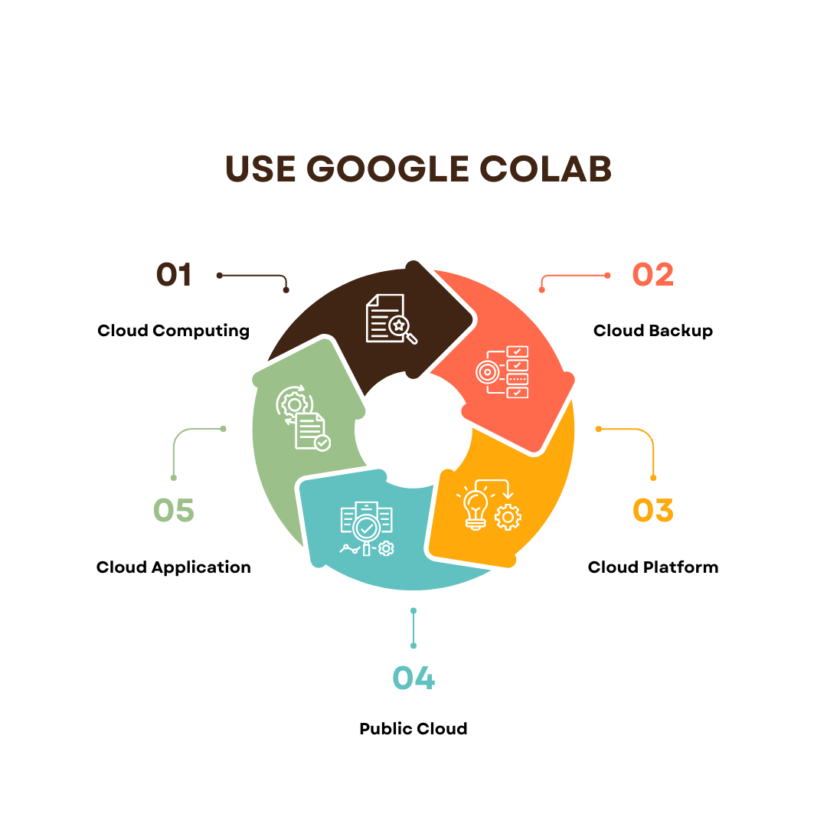
Why Use Google Colab?
Google Colab is ideal for data science and machine learning projects due to its free access to GPUs and ease of use in the cloud.

Slide 5
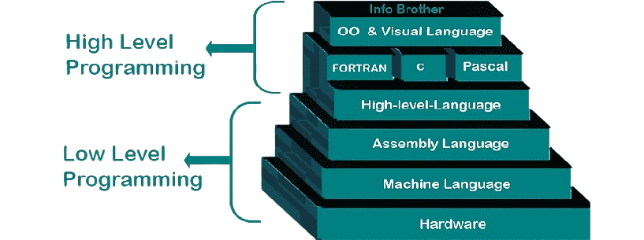
What is Programming? (Machine Language, High-Level Language)
Programming is the process of creating instructions that a computer can execute, from machine language (binary) to high-level languages (Python, Java).

Slide 6
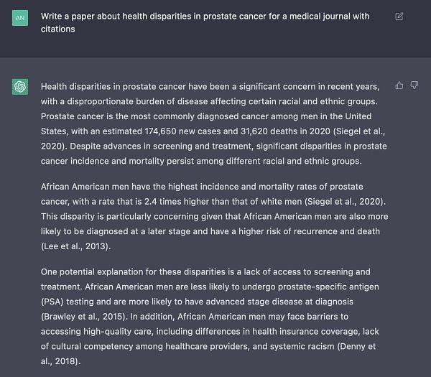
What is Prompt Engineering?
Prompt engineering is the practice of designing effective prompts to achieve desired outcomes when interacting with AI models.

Slide 7
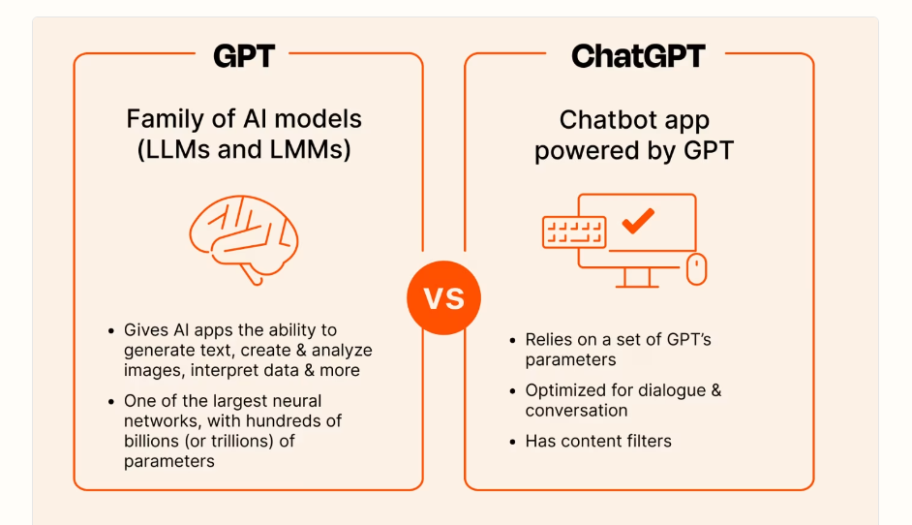
What is ChatGPT?
ChatGPT is an AI language model developed by OpenAI, designed to understand and generate human-like text responses based on prompts.

Slide 8
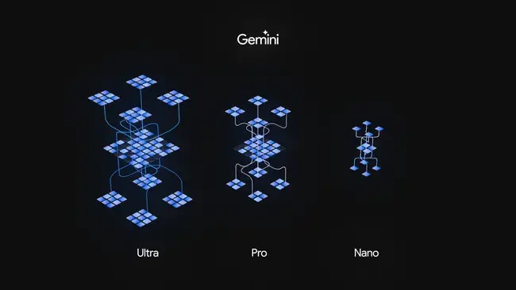
What is Google Gemini?
Google Gemini is an AI model by Google aimed at advancing AI understanding and multimodal interactions across text, image, and audio inputs.
Powered by Google AI

Slide 9


Ready to get started ?
There's no one "best" programming language, and once you've learned one, it's fairly easy to pick up another, so don't get hung up on choosing your first language.

Slide 10
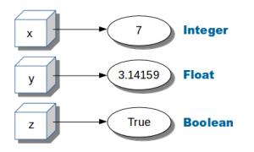
Variable in Python
Syntax:
A variable in Python is a name given to a memory location that stores data and allows for its manipulation throughout the program.
variable_name = value
Prompt
Create a Python code that demonstrates variable declaration and assignment, with examples of integer, string, and float variables.

Slide 11
Example Code:
Output:
# Variable declaration and assignment in Python
name = "Alice"# String variable
age = 30 # Integer variable
height = 5.7 # Float variable
print("Name:", name)
print("Age:", age)
print("Height:", height)
Name: Alice
Age: 30
Height: 5.7

Slide 12
Integer (int)
Syntax:
An integer in Python is a whole number without a fractional part, defined as int in typing.
age: int = 30
Prompt
"Create Python code demonstrating the use of the int type with examples of positive and negative integers."

Slide 13
Example Code:
# Integer example
age: int = 25
temperature: int = -5
print("Age:", age)
print("Temperature:", temperature)

Slide 14
Float (float)
Syntax:
A float in Python represents a number with a decimal point, defined as float in typing.
height: float = 5.9
Prompt
"Create Python code demonstrating the use of the float type, showing examples with positive and negative decimal numbers."

Slide 15
Example Code:
# Float example
height: float = 5.9
weight: float = 70.5
print("Height:", height)
print("Weight:", weight)

Slide 16
String (str)
Syntax:
A string in Python is a sequence of characters, defined as str in typing.
name: str = "Alice"
Prompt
"Create Python code that demonstrates the use of the str type, showing examples with names and sentences."

Slide 17
Example Code:
# String example
name: str = "Alice"
greeting: str = "Hello, world!"
print("Name:", name)
print("Greeting:", greeting)

Slide 18
Boolean (bool)
Syntax:
A boolean in Python represents a truth value, defined as bool in typing, with possible values True or False.
is_student: bool = True
Prompt
"Create Python code demonstrating the use of the bool type with examples showing true and false conditions."

Slide 19
Example Code:
# Boolean example
is_student: bool = True
is_employed: bool = False
print("Is student:", is_student)
print("Is employed:", is_employed)

Slide 20
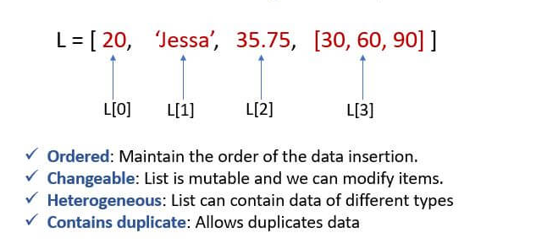
list (list)
Syntax:
A list in Python is an ordered, mutable collection of items, defined as list[type] in typing.
scores: list[int] = [85, 90, 75]
Prompt
"Create Python code demonstrating the use of the list type, showing examples of integer and string lists."

Slide 21
Example Code:
# list example
names: list[str] = ["Alice", "Bob", "Charlie"]
scores: list[int] = [85, 90, 75]
print("Names:", names)
print("Scores:", scores)

Slide 22
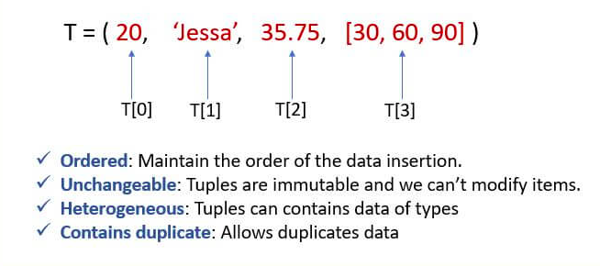
Tuple (Tuple)
Syntax:
A tuple in Python is an ordered, immutable collection of items, defined as Tuple[type1, type2, ...] in typing.
person: tuple[str, int] = ("Alice", 25)
Prompt
"Create Python code demonstrating the use of the Tuple type, with examples showing mixed data types."

Slide 23
Example Code:
# Tuple example
person: tuple[str, int] = ("Alice", 25)
coordinates: tuple[float, float] = (40.7128, -74.0060)
print("Person:", person)
print("Coordinates:", coordinates)

Slide 24
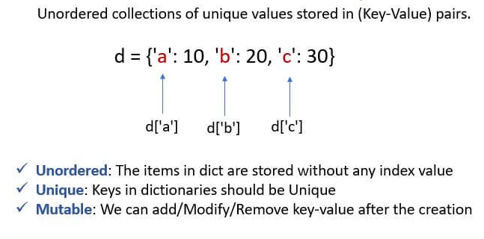
Dictionary (Dict)
Syntax:
A dictionary in Python is a collection of key-value pairs, defined as Dict[key_type, value_type] in typing.
student: dict[str, int] = {"Alice": 25, "Bob": 30}
Prompt
"Create Python code demonstrating the use of the Dict type, with examples showing student names as keys and ages as values."

Slide 25
Example Code:
# Dictionary example
student_ages: dict[str, int] = {"Alice": 25, "Bob": 22}
scores: dict[str, float] = {"Math": 85.5, "Science": 90.0}
print("Student Ages:", student_ages)
print("Scores:", scores)

Slide 26
Basic list Creation
Syntax:
A list is an ordered collection of elements, created using square brackets [] in Python.
my_list: list[type] = [element1, element2, element3]
Prompt
"Create a Python list containing three integer elements."

Slide 27
Example Code:
# Basic list example
numbers: list[int] = [10, 20, 30]
print("Numbers:", numbers)

Slide 28
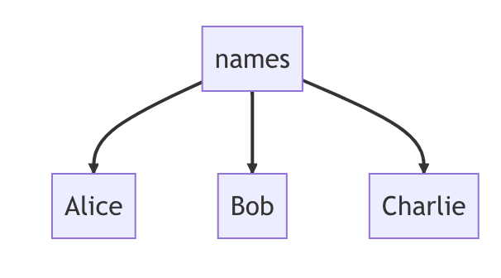
list of Strings
Syntax:
A list can store strings as elements, making it ideal for text-based collections.
names: list[str] = ["Alice", "Bob", "Charlie"]
Prompt
"Create a Python list containing three string elements representing names."

Slide 29
Example Code:
# list of Strings example
names: list[str] = ["Alice", "Bob", "Charlie"]
print("Names:", names)

Slide 30
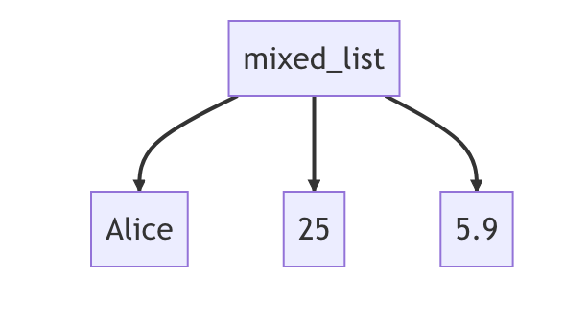
list of Mixed Data Types
Syntax:
A list can hold different data types together, such as integers, floats, and strings.
mixed_list: list[Any] = ["Alice", 25, 5.9]
Prompt
"Create a Python list containing elements of different types: a string, an integer, and a float."

Slide 31
Example Code:
# list of Mixed Data Types example
mixed_list: list[Any] = ["Alice", 25, 5.9]
print("Mixed list:", mixed_list)

Slide 32
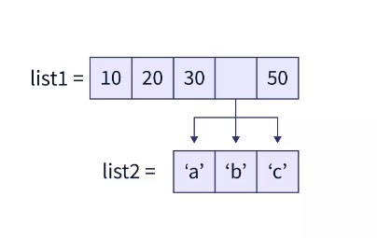
Nested lists (lists within lists)
Syntax:
matrix: list[list[int]] = [[1, 2, 3], [4, 5, 6]]
A nested list is a list that contains other lists as elements, creating a multi-dimensional structure.
Prompt
"Create a Python nested list representing a 2x3 matrix."

Slide 33
Example Code:
# Nested list example
matrix: list[list[int]] = [[1, 2, 3], [4, 5, 6]]
print("Matrix:", matrix)

Slide 34
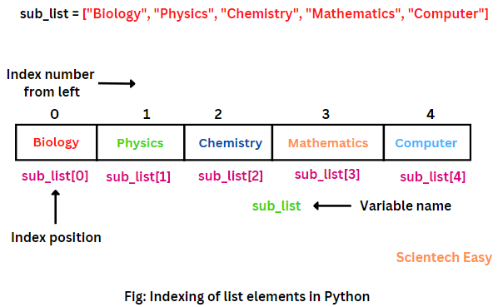
Accessing list Elements by Index
Syntax:
element = my_list[index]
Elements in a list can be accessed using their index, starting from 0.
Prompt
"Create Python code to access the first and last elements of a list of colors."

Slide 35
Example Code:
# Accessing list Elements by Index example
colors: list[str] = ["red", "green", "blue"]
first_color = colors[0]
last_color = colors[-1]
print("First Color:", first_color)
print("Last Color:", last_color)

Slide 36
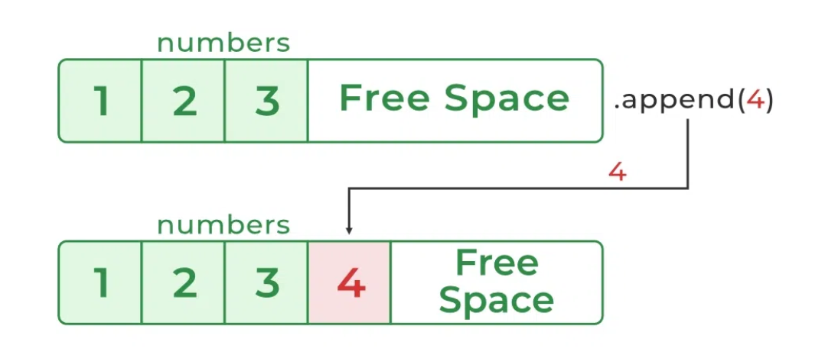
Adding Elements to a list (append)
Syntax:
my_list.append(new_element)
The append() method adds an element to the end of a list.
Prompt
"Create Python code to add a new color to an existing list of colors using append."

Slide 37
Example Code:
# Append example
colors: list[str] = ["red", "green"]
colors.append("blue")
print("Updated Colors:", colors)

Slide 38
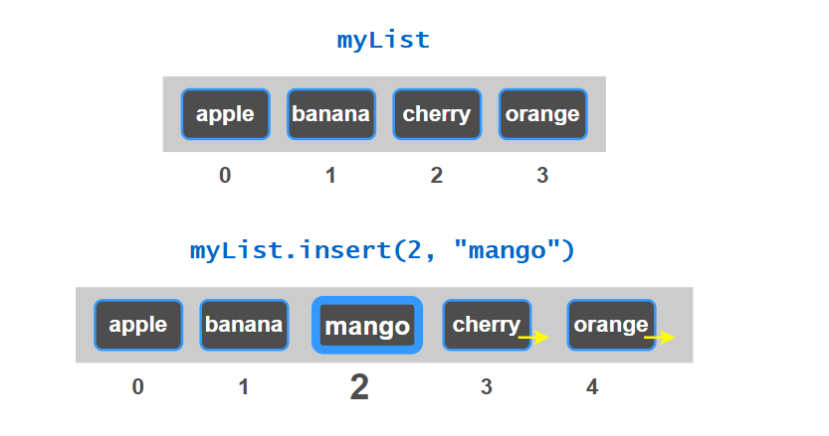
Inserting Elements at a Specific Position (insert)
Syntax:
my_list.insert(index, new_element)
The insert() method adds an element at a specific index in the list.
Prompt
"Create Python code to insert a color at the beginning of a list using insert."

Slide 39
Example Code:
# Intersect example
colors: list[str] = ["green", "blue"]
colors.insert(0, "red")
print("Updated Colors:", colors)

Slide 40
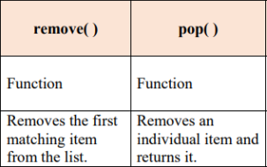
Removing Elements (remove and pop)
Syntax:
my_list.remove(element)
my_list.pop(index)
The remove() method deletes a specific element, while pop() removes an element by index.
Prompt
"Create Python code to remove elements by value and by index from a list."

Slide 41
Example Code:
# Remove and Pop example
colors: list[str] = ["red", "green", "blue"]
colors.remove("green")
last_color = colors.pop()
print("Updated Colors:", colors)
print("Removed Color:", last_color)

Slide 42
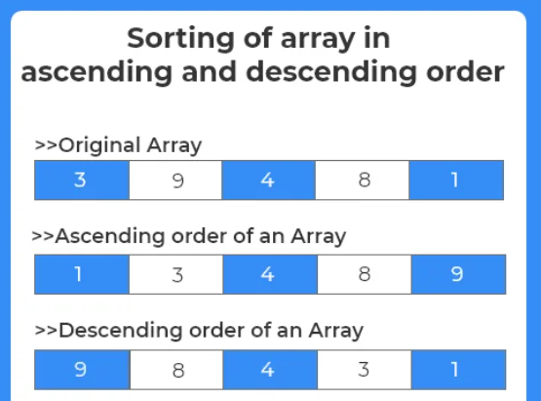
Sorting a list (sort)
Syntax:
The sort() method arranges the list elements in ascending or descending order.
my_list.sort() # Ascending
my_list.sort(reverse=True) # Descending
Prompt
"Create Python code to sort a list of numbers in ascending and descending order."

Slide 43
Example Code:
# Sorting list example
numbers: list[int] = [3, 1, 4, 1, 5, 9]
numbers.sort()
print("Ascending:", numbers)
numbers.sort(reverse=True)
print("Descending:", numbers)

Slide 44
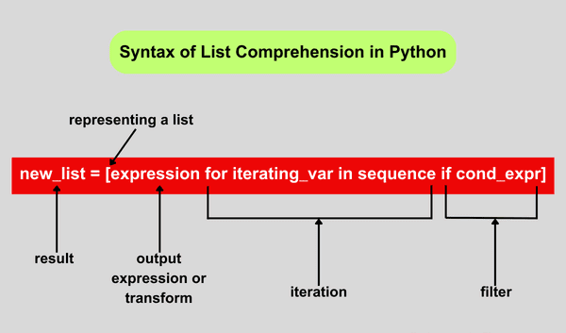
list Comprehensions
Syntax:
list comprehensions provide a concise way to create lists using a single line of code.
new_list = [expression for item in iterable]
Prompt
"Create Python code using list comprehension to generate a list of squares from 1 to 5."

Slide 45
Example Code:
# list Comprehensions example
squares: list[int] = [x ** 2 for x in range(1, 6)]
print("Squares:", squares)

Slide 46
Basic Tuple Creation
Syntax:
A tuple is an immutable, ordered collection of elements in Python, created using parentheses ().
my_tuple: Tuple[type, ...] = (element1, element2, element3)
Prompt
"Create a Python tuple containing three integer elements."

Slide 47
Example Code:
# Tuple Creation example
numbers: Tuple[int, int, int] = (10, 20, 30)
print("Numbers:", numbers)

Slide 48
Tuple with Mixed Data Types
Syntax:
mixed_tuple: Tuple[str, int, float] = ("Alice", 25, 5.9)
A tuple can store elements of different data types, like strings, integers, and floats.
Prompt
"Create a Python tuple with elements of different types: a string, an integer, and a float."

Slide 49
Example Code:
# Tuple with Mixed Data Types example
mixed_tuple: Tuple[str, int, float] = ("Alice", 25, 5.9)
print("Mixed Tuple:", mixed_tuple)

Slide 50
Accessing Tuple Elements by Index
Syntax:
element = my_tuple[index]
Elements in a tuple can be accessed using their index, starting from 0.
Prompt
The ways by which we can access elements of a tuple in Python. They are as:
Indexing
Negative indexing
Slicing
"Create Python code to access the first and last elements of a tuple of colors."

Slide 51
Example Code:
#Accessing Tuple Elements by Index example colors: tuple[str, str, str] = ("red", "green", "blue")
first_color = colors[0]
last_color = colors[-1]
print("First Color:", first_color)
print("Last Color:", last_color)

Slide 52
Nested Tuples (Tuples within Tuples)
Syntax:
nested_tuple: Tuple[Tuple[int, ...], Tuple[int, ...]] = ((1, 2), (3, 4))
A nested tuple is a tuple that contains other tuples as elements.
Prompt
"Create a Python nested tuple representing a 2x2 matrix."

Slide 53
Example Code:
# Nested Tuple example
matrix: tuple[tuple[int, int], Tuple[int, int]] = ((1, 2), (3, 4))
print("Matrix:", matrix)

Slide 54
Single-Element Tuple
Syntax:
To create a tuple with a single element, a comma must follow the element.
single_element_tuple: tuple[int] = (5,)
Prompt
"Create a Python tuple containing only one integer element."

Slide 55
Example Code:
# Single Element Tuple example
single_element_tuple: tuple[int] = (5,)
print("Single Element Tuple:", single_element_tuple)

Slide 56
Tuple Unpacking
Syntax:
Tuple unpacking allows multiple variables to be assigned values from a tuple in a single statement.
a, b, c = my_tuple
Prompt
"Create Python code to unpack a tuple of three colors into individual variables."

Slide 57
Example Code:
# Tuple Unpacking example
colors: tuple[str, str, str] = ("red", "green", "blue")
color1, color2, color3 = colors
print("Color 1:", color1)
print("Color 2:", color2)
print("Color 3:", color3)

Slide 58
Using Tuples as Dictionary Keys
Syntax:
my_dict: dict[tuple[int, int], str] = {(1, 2): "point1", (3, 4): "point2"}
Tuples can be used as keys in dictionaries because they are immutable.
Prompt
"Create Python code using tuples as keys in a dictionary."

Slide 59
Example Code:
# Tuples as Dictionary Keys example
coordinates: dict[tuple[int, int], str] = {(1, 2): "Point A", (3, 4): "Point B"}
print("Coordinates:", coordinates)

Slide 60
Tuple Concatenation
Syntax:
Tuples can be concatenated using the + operator, resulting in a new tuple.
new_tuple = tuple1 + tuple2
Prompt
"Create Python code to concatenate two tuples of numbers."

Slide 61
Example Code:
# Tuple Concatenation example
tuple1: tuple[int, int] = (1, 2)
tuple2: tuple[int, int] = (3, 4)
concatenated_tuple = tuple1 + tuple2
print("Concatenated Tuple:", concatenated_tuple)

Slide 62
Tuple Slicing
Syntax:
Like lists, tuples support slicing to access a range of elements.
sliced_tuple = my_tuple[start:end]
Prompt
"Create Python code to slice a tuple of numbers, extracting the first two elements."

Slide 63
Example Code:
# Tuple Slicing example
numbers: Tuple[int, int, int, int] = (10, 20, 30, 40)
first_two = numbers[:2]
print("First Two Elements:", first_two)

Slide 64
Finding the Length of a Tuple
Syntax:
length = len(my_tuple)
The len() function returns the number of elements in a tuple.
Prompt
"Create Python code to find the length of a tuple of numbers."

Slide 65
Example Code:
# To Find the length of a Tuple example
numbers: Tuple[int, int, int] = (10, 20, 30)
length = len(numbers)
print("Length of Tuple:", length)

Slide 66
Basic Dictionary Creation
Syntax:
A dictionary is an unordered collection of key-value pairs in Python.
my_dict: dict[str, int] = {"key1": value1, "key2": value2}
Prompt
"Create a Python dictionary with two key-value pairs: a string key and an integer value."

Slide 67
Example Code:
# Basic Dictionary Creation example
person_age: dict[str, int] = {"Alice": 25, "Bob": 30}
print("Person Age Dictionary:", person_age)

Slide 68
Accessing Dictionary Values by Key
Syntax:
value = my_dict["key"]
Values in a dictionary are accessed using their associated keys.
Prompt
"Create Python code to access the value associated with the key 'Alice' in a dictionary."

Slide 69
Example Code:
# Accessing Dictionary Values by Key example
person_age = {"Alice": 25, "Bob": 30}
alice_age = person_age["Alice"]
print("Alice's Age:", alice_age)

Slide 70
Adding or Updating a Dictionary Entry
Syntax:
my_dict["new_key"] = new_value
Add or update dictionary entries by assigning a new key-value pair.
Prompt
"Create Python code to add a new key-value pair to a dictionary."

Slide 71
Example Code:
# To Add & Update Dictionary Entry example
person_age = {"Alice": 25}
person_age["Bob"] = 30
print("Updated Dictionary:", person_age)

Slide 72
Removing a Dictionary Entry
Syntax:
del my_dict["key"]
Use del or pop() to remove a key-value pair from a dictionary.
Prompt
"Create Python code to remove the key 'Alice' from a dictionary."

Slide 73
Example Code:
# To Remove a Dictionary Entry example
person_age = {"Alice": 25, "Bob": 30}
del person_age["Alice"]
print("After Deletion:", person_age)

Slide 74
Checking for a Key in a Dictionary
Syntax:
if "key" in my_dict:
# Do something
Use the in keyword to check if a key exists in a dictionary.
Prompt
"Create Python code to check if 'Bob' exists in a dictionary."

Slide 75
Example Code:
# To Check for a Key in Dictionary Entry example
person_age = {"Alice": 25, "Bob": 30}
print("Is 'Bob' in dictionary?", "Bob" in person_age)

Slide 76
Iterating Over a Dictionary
Syntax:
Loop through keys or key-value pairs in a dictionary using for loops.
for key, value in my_dict.items():
# Do something with key and value
Prompt
"Create Python code to iterate over a dictionary and print each key and value."

Slide 77
Example Code:
# To Iterate Over a Dictionary Entry example
person_age = {"Alice": 25, "Bob": 30}
for name, age in person_age.items():
print(f"{name} is {age} years old")

Slide 78
Dictionary Comprehension
Syntax:
Dictionary comprehension creates dictionaries in a concise way, similar to list comprehensions.
squared_numbers = {x: x**2 for x in range(5)}
Prompt
"Create Python code to generate a dictionary with numbers as keys and their squares as values."

Slide 79
Example Code:
# Dictionary Comprehension example
squares = {num: num ** 2 for num in range(1, 6)}
print("Squares Dictionary:", squares)

Slide 80
Nested Dictionary
Syntax:
A nested dictionary is a dictionary containing another dictionary as a value.
nested_dict = {"person1": {"name": "Alice", "age": 25}}
Prompt
"Create Python code for a nested dictionary representing two people with names and ages."

Slide 81
Example Code:
# Nested Dictionary example
people = {
"person1": {"name": "Alice", "age": 25},
"person2": {"name": "Bob", "age": 30}
}
print("Nested Dictionary:", people)

Slide 82
Merging Dictionaries
Syntax:
Use the update() method or {**dict1, **dict2} syntax to merge dictionaries.
combined_dict = {**dict1, **dict2}
Prompt
"Create Python code to merge two dictionaries."

Slide 83
Example Code:
# To Merge Dictionaries example
dict1 = {"Alice": 25}
dict2 = {"Bob": 30}
merged_dict = {**dict1, **dict2}
print("Merged Dictionary:", merged_dict)

Slide 84
Using get() Method
Syntax:
get() method returns the value for a key if it exists, or a default if it doesn’t.
value = my_dict.get("key", "default"
Prompt
"Create Python code using get() to safely access a key in a dictionary."

Slide 85
Example Code:
# Use of get Method example
person_age = {"Alice": 25}
print("Alice's Age:", person_age.get("Alice", "Not found"))
print("Bob's Age:", person_age.get("Bob", "Not found"))

Slide 86
Counting Frequency Using a Dictionary
Syntax:
frequency_dict = {}
for item in items:
frequency_dict[item] = frequency_dict.get(item, 0) + 1
Dictionaries can be used to count the frequency of elements in a list.
Prompt
"Create Python code to count occurrences of elements in a list using a dictionary."

Slide 87
Example Code:
# To Count Frequency Using a Dictionary example
items = ["apple", "banana", "apple", "orange", "banana"]
frequency = {}
for item in items:
frequency[item] = frequency.get(item, 0) + 1
print("Frequency Count:", frequency)

Slide 88
Dictionary Methods Overview
Python dictionaries come with built-in methods for various operations like clearing, copying, and more.
Prompt
"list the most commonly used dictionary methods with examples for each."

Slide 89
Example Code:
# Dictionary Methods example
person_age = {"Alice": 25, "Bob": 30}
print("Keys:", person_age.keys()) # Get all keys
print("Values:", person_age.values()) # Get all values
print("Items:", person_age.items()) # Get all key-value pairs
copied_dict = person_age.copy() # Copy dictionary
person_age.clear() # Clear dictionary
print("Cleared Dictionary:", person_age)

Slide 90
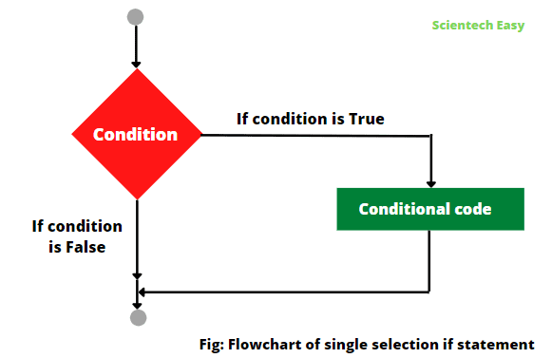
Basic If Statement
Syntax:
An if statement evaluates a condition and executes a block of code if the condition is true.
if condition:
# code to execute
Prompt
"Create Python code with an if statement that prints 'Condition is True' if a variable is greater than 10."

Slide 91
Example Code:
#If Statement example
number = 15
if number > 10:
print("Condition is True")

Slide 92
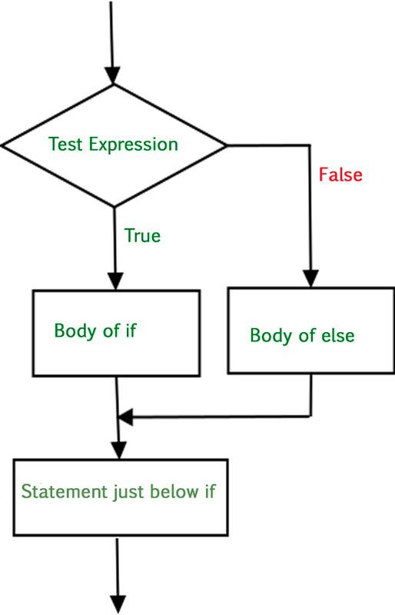
If-Else Statement
Syntax:
An if-else statement provides an alternative block of code to execute when the condition is false.
if condition:
# code to execute if true
else:
# code to execute if false
Prompt
"Create Python code with an if-else statement that prints whether a number is odd or even."

Slide 93
Example Code:
# If Else Statement example
number = 4
if number % 2 == 0:
print("Even")
else:
print("Odd")

Slide 94
If-Elif-Else Statement
Syntax:
An if-elif-else statement allows for multiple conditions to be checked sequentially.
if condition1:
# code for condition1
elif condition2:
# code for condition2
else:
# code if none of the conditions are true
Prompt
"Create Python code with an if-elif-else structure that categorizes a number as positive, negative, or zero."

Slide 95
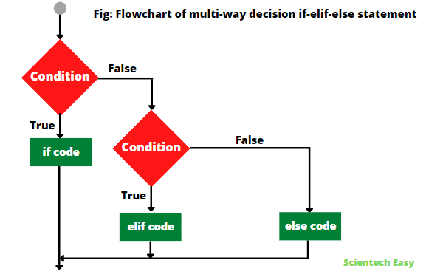
Example Code:
# If-Elif-Else Statement example
number = 0
if number > 0:
print("Positive")
elif number < 0:
print("Negative")
else:
print("Zero")

Slide 96
Nested If Statements
Syntax:
Nested if statements allow for a conditional check inside another if statement.
if condition1:
if condition2:
# code for condition2
Prompt
"Create Python code using nested if statements to check if a number is positive and even."

Slide 97
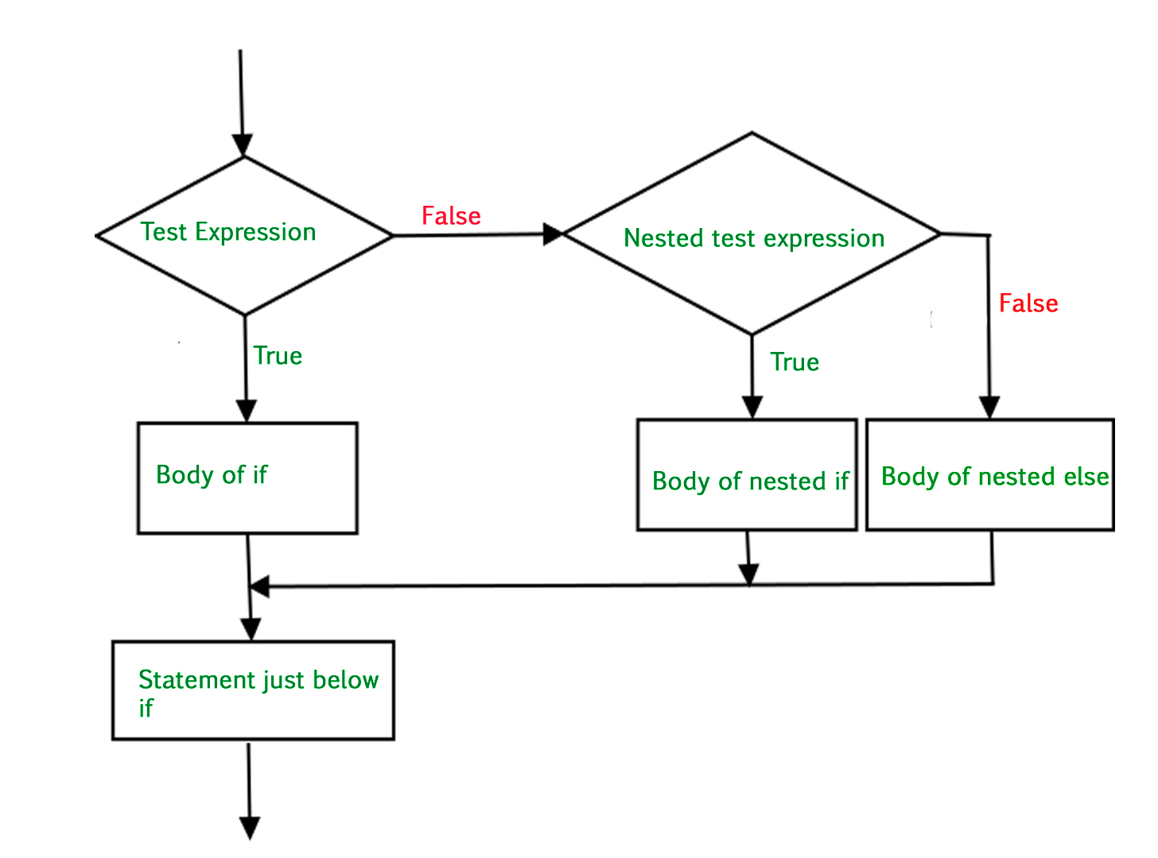
Example Code:
# Nested If Statement example
number = 8
if number > 0:
if number % 2 == 0:
print("Positive and Even")

Slide 98
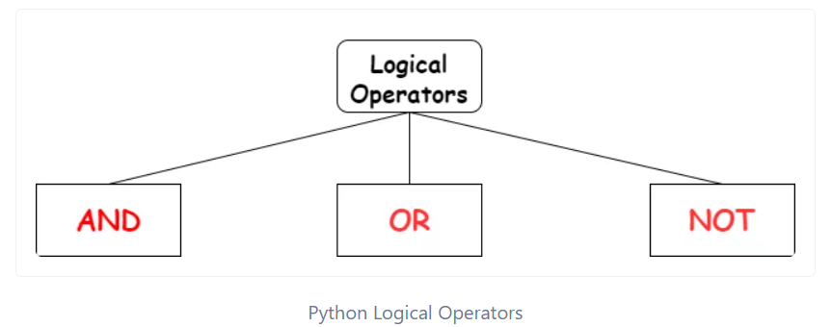
Using Logical Operators
Syntax:
Logical operators and, or, and not combine multiple conditions in an if statement.
if condition1 and condition2:
# code if both conditions are true
Prompt
"Create Python code to check if a number is between 1 and 10 using logical operators."

Slide 99
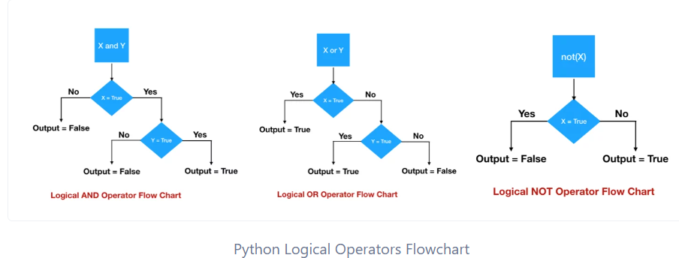
Example Code:
# Logical Operators example
number = 5
if number > 1 and number < 10:
print("Number is between 1 and 10")

Slide 100
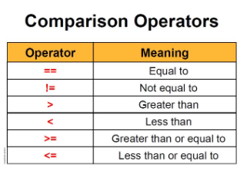
Using Comparison Operators
Syntax:
if value1 == value2:
# code if values are equal
Comparison operators like ==, !=, <, >, <=, >= are used to compare values in conditional statements.
Prompt
"Create Python code to compare two numbers and print which one is greater."

Slide 101
Example Code:
# Comparison Operators example
a = 10
b = 20
if a > b:
print("a is greater")
elif a < b:
print("b is greater")
else:
print("Both are equal")

Slide 102
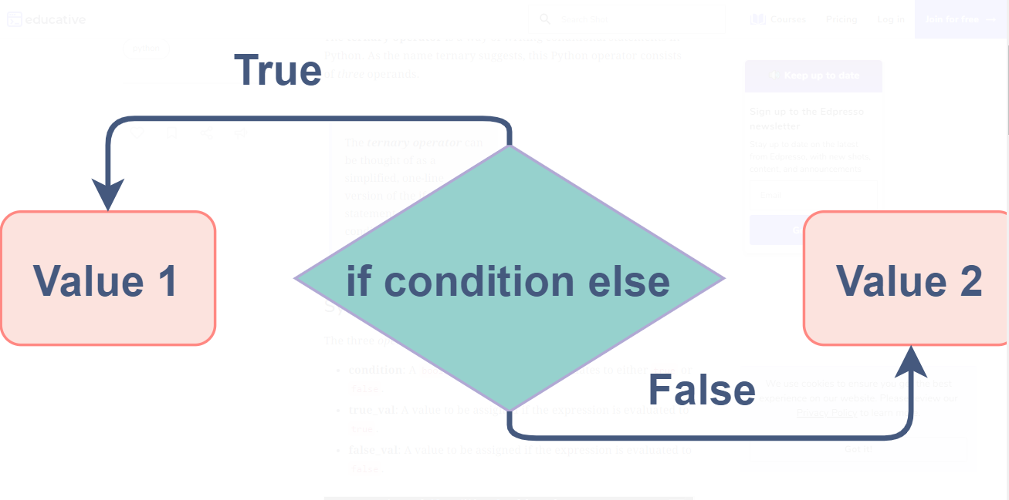
Ternary Conditional Operator
Syntax:
value = true_value if condition else false_value
The ternary operator allows for a concise way to write an if-else statement in a single line.
Prompt
"Create Python code using the ternary operator to determine if a number is even or odd."

Slide 103
Example Code:
# Ternary Conditional Operator example
number = 7
result = "Even" if number % 2 == 0 else "Odd"
print("The number is", result)

Slide 104
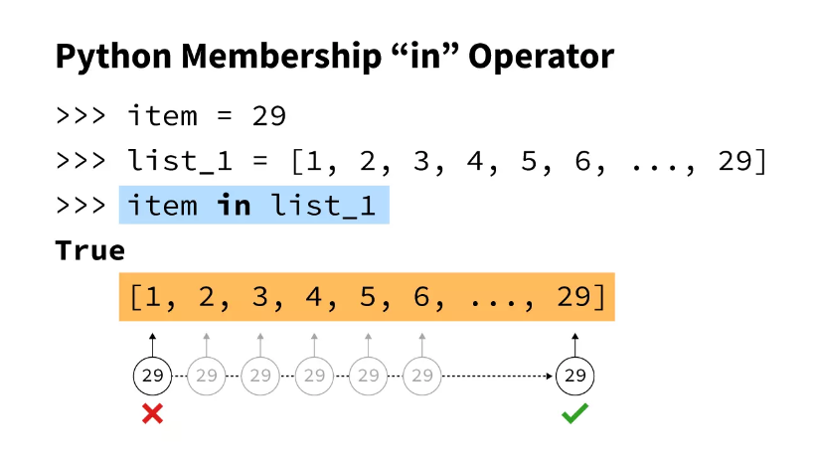
Using ‘in’ Keyword for Membership Testing
Syntax:
if item in collection:
# code if item is found
The in keyword checks for the presence of an item in a collection like a list or string.
Prompt
"Create Python code to check if an element exists in a list."

Slide 105
Example Code:
# Use of “in” Keyword example
fruits = ["apple", "banana", "cherry"]
if "banana" in fruits:
print("Banana is in the list")

Slide 106
Using ‘not’ Keyword for Negation
Syntax:
if not condition:
# code if condition is false
The not keyword negates a boolean value, reversing its result in conditional checks.
Prompt
"Create Python code using not to check if a number is not zero."

Slide 107
Example Code:
# Use of “not” Keyword example
number = 0
if not number:
print("Number is zero")

Slide 108
Using ‘elif’ for Multiple Conditions
Syntax:
if condition1:
# code
elif condition2:
# code
elif condition3:
# code
The elif keyword allows for additional checks after the first if, enabling multiple conditions.
Prompt
"Create Python code that checks multiple grades and assigns letter grades."

Slide 109
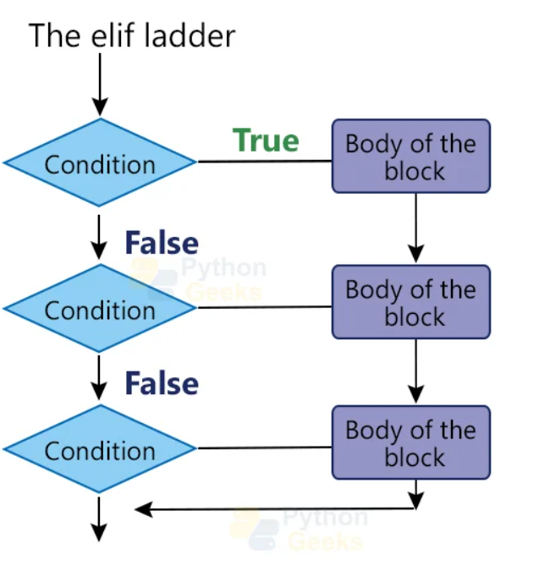
Example Code:
# Use of Elif for Multiple Conditions example
grade = 85
if grade >= 90:
print("A")
elif grade >= 80:
print("B")
elif grade >= 70:
print("C")
else:
print("D or F")

Slide 110
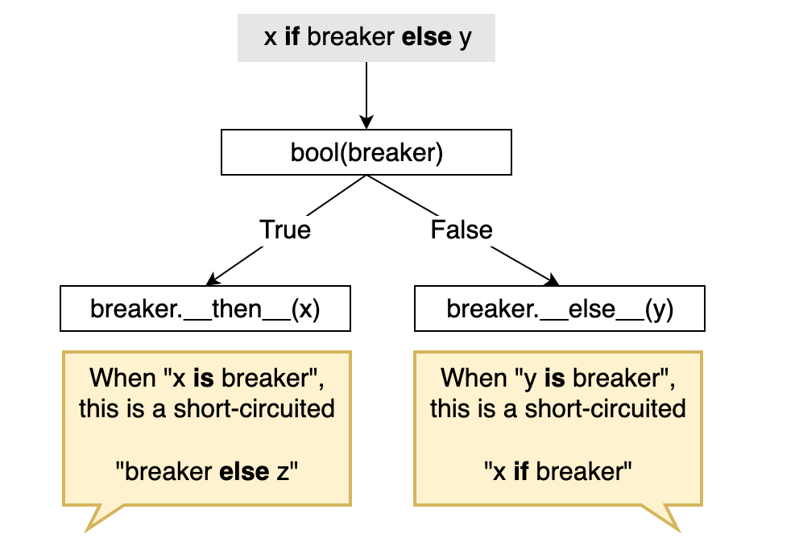
Using Short-Circuit Evaluation
Syntax:
if condition1 or condition2:
# code if either condition is true
Short-circuit evaluation occurs when the interpreter stops evaluating conditions as soon as the outcome is determined.
Prompt
"Create Python code to demonstrate short-circuit evaluation with logical operators."

Slide 111
Example Code:
# Short Circuit Evaluation example
a = 5
b = 0
if b != 0 and (a / b) > 1: # The second condition won't be evaluated due to short-circuit
print("Safe to divide")

Slide 112
Switch Case Alternative (Using Dictionaries)
Syntax:
def switch_case(value):
switch = {
"case1": action1,
"case2": action2,
}
return switch.get(value, default_action)
Python does not have a built-in switch-case statement; however, dictionaries can be used as an alternative.
Prompt
"Create a Python function that simulates a switch-case using a dictionary."

Slide 113
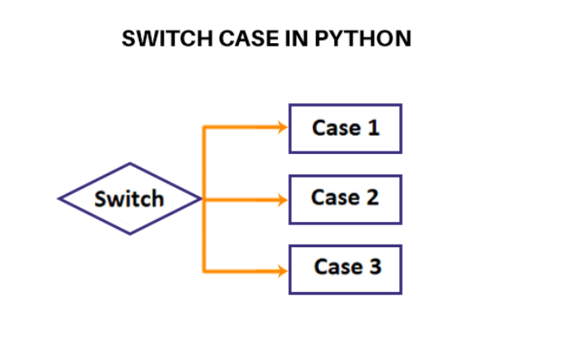
Example Code:
# Use of Switch Case Statement example
def switch_case(day):
days = {
1: "Monday",
2: "Tuesday",
3: "Wednesday"
}
return days.get(day, "Invalid day")
print(switch_case(2)) # Output: Tuesday

Slide 114
Introduction to Loops
Syntax:
Loops are used to execute a block of code repeatedly based on a condition.
# For loop
for item in iterable:
# code to execute
# While loop
while condition:
# code to execute
Prompt
"Create Python code that demonstrates the use of loops to iterate through a list."

Slide 115
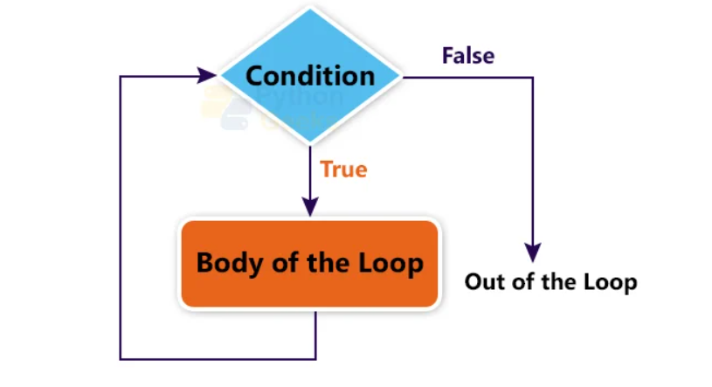
Example Code:
# Use of Loops example
fruits = ["apple", "banana", "cherry"]
for fruit in fruits:
print(fruit)

Slide 116
For Loop with Range
Syntax:
A for loop can iterate over a sequence of numbers generated by the range() function.
for i in range(start, stop, step):
# code to execute
Prompt
"Create Python code using a for loop with range to print numbers from 0 to 9."

Slide 117
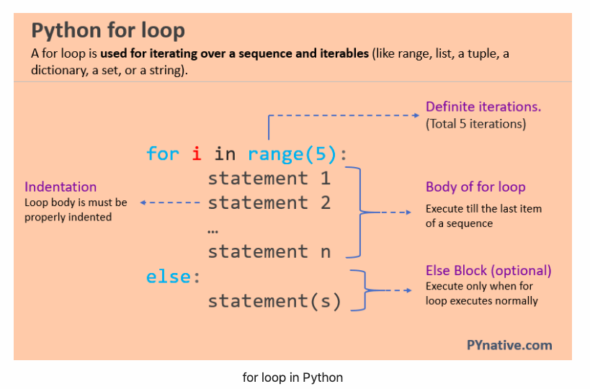
Example Code:
# For Loop With Range example
for i in range(10):
print(i)

Slide 118
While Loop
Syntax:
A while loop repeatedly executes a block of code as long as a specified condition is true.
while condition:
# code to execute
Prompt
"Create Python code using a while loop to print numbers from 1 to 5."

Slide 119
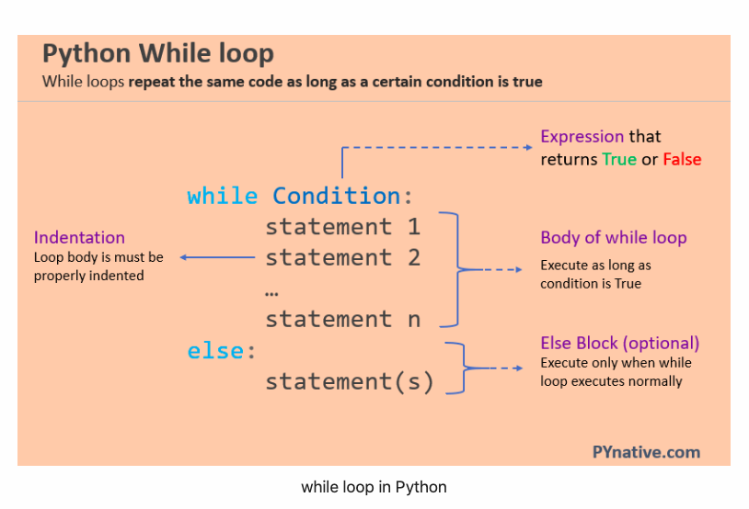
Example Code:
# While Loop example
count = 1
while count <= 5:
print(count)
count += 1

Slide 120
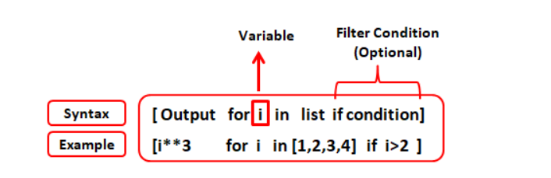
For Loop with list Comprehension
Syntax:
new_list = [expression for item in iterable if condition]
list comprehension provides a concise way to create lists using a for loop within brackets.
Prompt
"Create Python code using list comprehension to generate a list of squares from 1 to 10."

Slide 121
Example Code:
# For Loop with list Comprehension example
squares = [x**2 for x in range(1, 11)]
print(squares)

Slide 122
Nested Loops
Syntax:
Nested loops are loops inside another loop, allowing for multi-dimensional iteration.
for item1 in iterable1:
for item2 in iterable2:
# code to execute
Prompt
"Create Python code using nested loops to print a multiplication table."

Slide 123
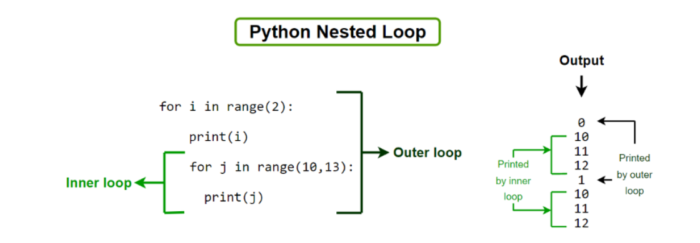
Example Code:
# Nested Loop example
for i in range(1, 6):
for j in range(1, 6):
print(i * j, end="\t")
print()

Slide 124
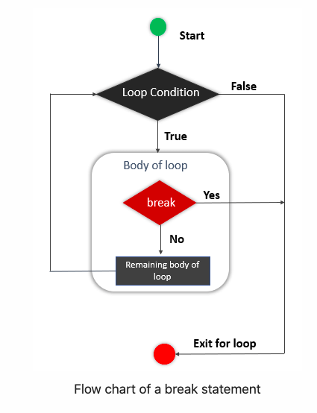
Break Statement
Syntax:
The break statement terminates the loop when a specified condition is met.
for item in iterable:
if condition:
break
Prompt
"Create Python code that uses the break statement to exit a loop when a certain number is reached."

Slide 125
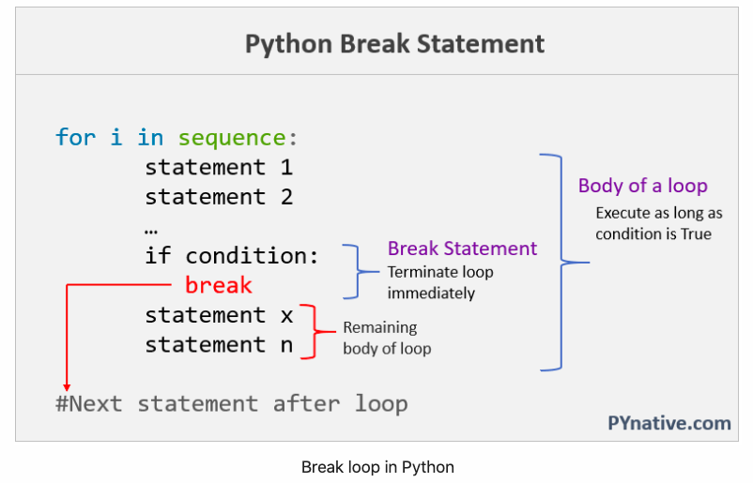
Example Code:
# Break Statement example
for i in range(10):
if i == 5:
break
print(i)

Slide 126
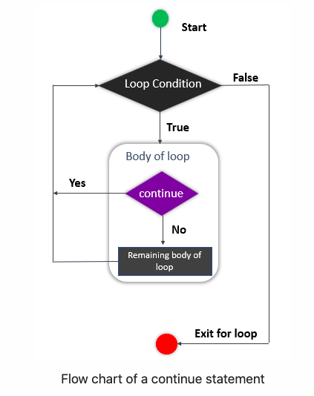
Continue Statement
Syntax:
The continue statement skips the current iteration and proceeds to the next iteration of the loop.
for item in iterable:
if condition:
continue
Prompt
"Create Python code that uses the continue statement to skip even numbers and print only odd numbers."

Slide 127
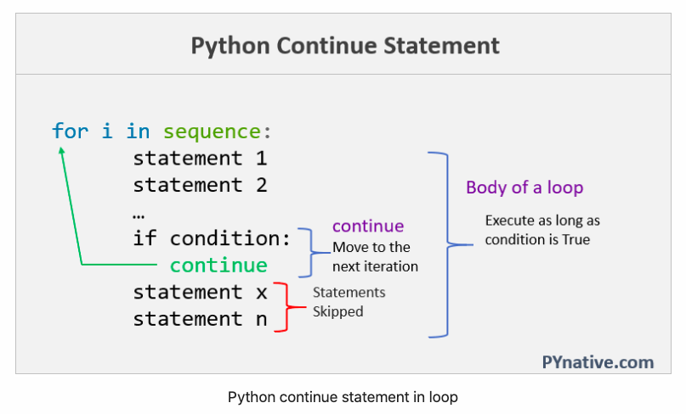
Example Code:
# Continue Statement example
for i in range(10):
if i % 2 == 0:
continue
print(i)

Slide 128
Using else with Loops
Syntax:
The else block after a loop executes when the loop completes without encountering a break statement.
for item in iterable:
# code to execute
else:
# code to execute if loop completes
Prompt
"Create Python code that demonstrates the use of else with a for loop."

Slide 129
Example Code:
# Using else with loops example
for i in range(3):
print(i)
else:
print("Loop completed without break.")

Slide 130
Looping Through Dictionaries
Syntax:
for key in dictionary:
# code to access key
for key, value in dictionary.items():
# code to access key and value
Loops can iterate over the keys, values, or key-value pairs of a dictionary.
Prompt
"Create Python code to loop through a dictionary and print keys and their corresponding values."

Slide 131
Example Code:
# Looping Through Dictionaries example
person = {"name": "Alice", "age": 30}
for key, value in person.items():
print(f"{key}: {value}")

Slide 132
Using Enumerate in Loops
Syntax:
The enumerate() function adds a counter to an iterable, returning both the index and the value during iteration.
for index, value in enumerate(iterable):
# code to access index and value
Prompt
"Create Python code using enumerate to iterate through a list with index."

Slide 133
Example Code:
# enumerate() function in loops example
fruits = ["apple", "banana", "cherry"]
for index, fruit in enumerate(fruits):
print(index, fruit)

Slide 134
Using zip() in Loops
Syntax:
The zip() function combines multiple iterables, allowing parallel iteration over them.
for item1, item2 in zip(iterable1, iterable2):
# code to access items
Prompt
"Create Python code that uses zip to iterate through two lists simultaneously."

Slide 135
Example Code:
# Zip in loops example
names = ["Alice", "Bob", "Charlie"]
ages = [25, 30, 35]
for name, age in zip(names, ages):
print(f"{name} is {age} years old.")

Slide 136
Using Infinite Loops
Syntax:
An infinite loop continues indefinitely unless a break statement is used or an external interruption occurs.
while True:
# code to execute
Prompt
"Create Python code that demonstrates an infinite loop that can be exited with a break statement."

Slide 137
Example Code:
# Infinite loops example
while True:
response = input("Type 'exit' to leave: ")
if response == 'exit':
break

Slide 138

Thank you
For your attention

